Slide 1
COMP 1017
Day 12

Slide 2
The Box Model

Slide 3
Every single element on a web page is rendered as a box.

Slide 4
Each box has four different parts:
content
padding
border
margin

Slide 5
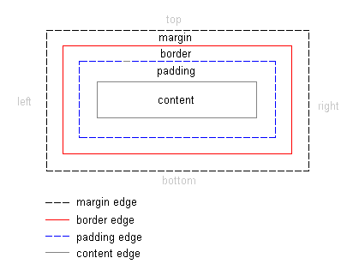

Slide 6
We’ve already got content mastered, so let’s focus on the other three parts.

Slide 7
Margin
White Space

Slide 8
The margin is the space around an element.

Slide 9
It can be used to push and pull elements around in the layout.

Slide 10
Margins can be controlled by:
top (margin-top)
right (margin-right)
bottom (margin-bottom)
left (margin-left)

Slide 11
… or, you can just control all sides with a single property.

Slide 12
margin: 5px 10px 5px 10px;
- The order is top, right, bottom, left. margin: 5px 10px;
- The order is top-bottom, right-left. margin: 5px 10px 15px;
- The order is top, right-left, bottom. margin: 30px;
- All margins will be 30px.

Slide 13
Border
The Space Around

Slide 14
The border is the line between margin and padding.

Slide 15
By default, the border has a width of zero, but we can make it thicker.

Slide 16
We can also control the style (pattern) and its colour (color).

Slide 17
The longhand declarations look something like this …

Slide 18
border-style: none|solid|dotted|dashed|double; /* etc. */
border-width: thin|medium|thick|1px;
border-color: red|#E51400|rgb(229,20,0)|rgba(229,20,0,100);

Slide 19
But we can simplify it.

Slide 20
border: 1px solid red;

Slide 21
As with margins, you can also target each side of the border.

Slide 22
Padding
The Space Within

Slide 23
Padding is the space around the element, inside of the border.

Slide 24
Think of it as like packing peanuts inside a box, protecting your content.

Slide 25
Padding behaves in a very similar way to margins.

Slide 26
Padding can be controlled by:
top (padding-top)
right (padding-right)
bottom (padding-bottom)
left (padding-left)

Slide 27
… or, you can just control all sides with a single property.

Slide 28
padding: 5px 10px 5px 10px;
- The order is top, right, bottom, left. padding: 5px 10px;
- The order is top-bottom, right-left. padding: 5px 10px 15px;
- The order is top, right-left, bottom. padding: 30px;
- All padding will be 30px.

Slide 29
Widths & Heights

Slide 30
When it comes to element sizes, it’s important to note that all parts of the box model contribute.

Slide 31
A box’s total width includes:
margin-left + border-left + padding-left + content width + padding-right + border-right + margin-right

Slide 32
A box’s total height includes:
border-top + padding-top + content height + padding-bottom + border-bottom

Slide 33
Supplemental Readings
http://kamleshshrestha.com.np/css-box-model/
https://torquemag.io/2018/06/css-box-model/
https://hackernoon.com/css-box-model-45ecf4ac219e
https://developer.mozilla.org/en-US/docs/Learn/CSS/Introduction_to_CSS/Box_model
https://codepen.io/carolineartz/full/ogVXZj

